Slide 1
Coursework 2016/17 Step 4

Slide 2
Step 4
15 marks for this step!
You need to implement a matching algorithm
If you provide a working step 4 (including everything from previous steps) and do the testing you should easily manage a B.
With good coding practice, a well written critical appraisal some extra effort on the user interface you could get an A

Slide 3
Step 4
Whenever a new request is entered in the system (and prior to looping to the next request)
Read the index file Requests.txt (either sequential read or unpickle depending on how you wrote the file)
For each request ID in the Requests.txt file
Check that file xxxxxx.pck exists on the local path
If not display warning and continue to next request ID
Unpickle contents of xxxxxx.pck and compare with current request (in memory)

Slide 4
Step 4
Things to note:
It only needs to match on module name to meet minimum requirement
You can choose which fields to match (must include module)
If you are matching on more than one field keep a note of number of matching criteria – brief asks for this but does not say what to do with the information
Perhaps could use it to rank the matching requests?

Slide 5
Step 4
Inform the user of the number of matches found
Rank them? – number of matched criteria or something else – you decide (this is where you can pick up extra marks)
Provide a means for the user to view each match found

Slide 6
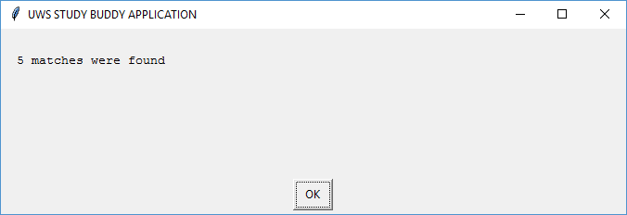
A basic example
Builds of the STEP 3 GUI program shown last week
After a request has been entered - Inform user of number of matches found

Slide 7
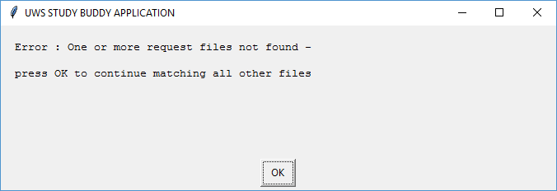
A basic example
After a request has been entered - File not found
How could this happen?

Slide 8
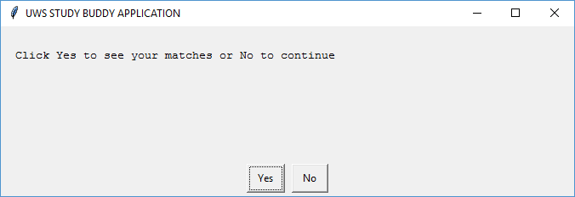
A basic example
Now ask the user if he wants to view his matches
Answering no completes the processing of the current request

Slide 9
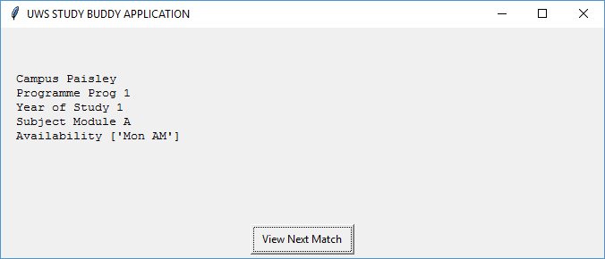
A basic example
Outputs information on a matching request using the display_restricted instance
Method of the Request class
User moves to the next request using the button (you could be ambitious and implement back and forward buttons to loop through matches (extra marks if it works)

Slide 10
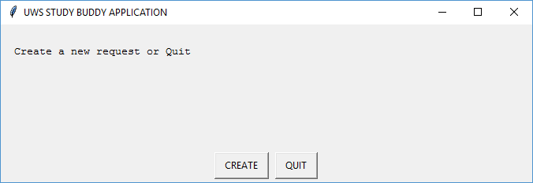
A basic example
Returns to menu when processing of all matches is complete

Slide 11
A basic example
This example matched on three criteria as follows-
Match found IF module matches AND campus matches AND programme matches.
It did not count the number of criteria matches (beyond the chosen3) nor did it rank matches in any specific order.
Whichever matching scheme you chooses it is IMPERATIVE that you fully document (using comments in the code and in your report) how your matching algorithm works (which fields it matches on, does it count the number of criteria matched and does it rank the matches (if so how?).
You MUST, as a minimum match on using module, you should fully justify the approach you take to matching in your critical appraisal

